Slide 1
Unified Mentor – Machine Learning Internship Project
Heart disease Prediction using
Machine Learning Models
Indumathi Rajendran

Slide 2
Agenda
Introduction
Dataset Overview
Data Preprocessing
Model Building
Model Evaluation
Deployment Architecture
User Interface
Use Case
Testing & Results
Conclusion
Future Scope

Slide 3
Dataset Overview
The dataset consists of medical data collected from patients, with 14 attributes describing health indicators and a target variable indicating heart disease presence. features include age, sex, chest pain type, resting blood pressure, cholesterol level, fasting blood sugar, ecg results, maximum heart rate, exercise-induced angina, oldpeak (st depression), and st segment slope. the target variable is binary: 0 = normal, 1 = heart disease.

Slide 4
Data Preprocessing
We began by handling missing or invalid data. Categorical variables such as chest pain type, ECG results, and ST slope were encoded using label encoding. Binary variables like sex and fasting blood sugar were mapped to 0 and 1. Numerical features were normalized to ensure uniformity across scales. Finally, the dataset was split into training and testing sets using an 80:20 ratio.

Slide 5
Exploratory Data Analysis (EDA)
We performed exploratory data analysis to understand patterns, correlations, and distributions of features in the dataset.
Plotted histograms and boxplots to visualize distribution of age, cholesterol, and blood pressure.
Correlation matrix showed strong relationships between chest pain type, max heart rate, and target class.
Checked for class imbalance and found a roughly even split.
Identified outliers in cholesterol and blood pressure for further analysis.

Slide 6
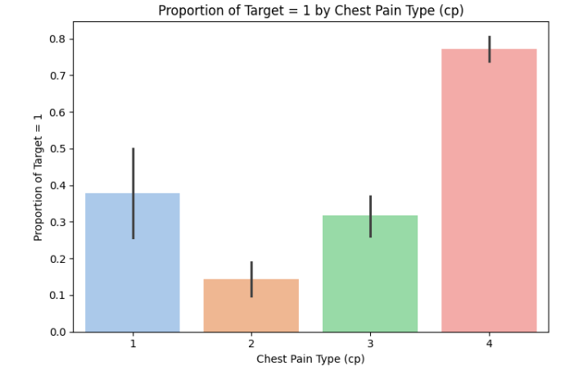
EDA- UNIVARIATE ANALYSIS

Slide 7
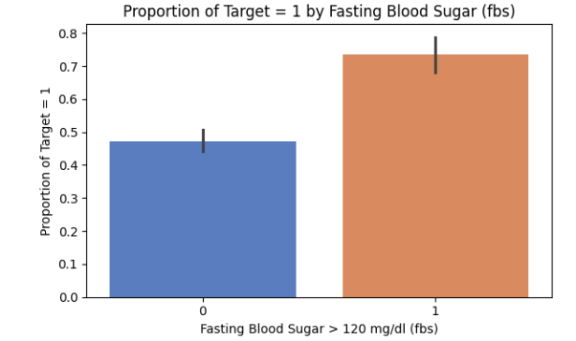
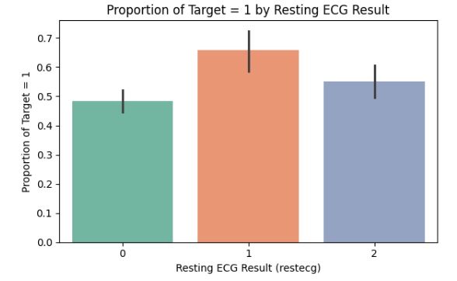
EDA- UNIVARIATE ANALYSIS

Slide 8
Model Building
Tested multiple classification algorithms including Logistic Regression, Decision Tree, and Random Forest. After comparing their performance, Random Forest was selected for its high accuracy and ability to handle feature importance. Hyperparameter tuning was performed to optimize the model’s performance using grid search.

Slide 9
Model Evaluation
The models were evaluated using accuracy, precision, recall, and F1-score. The Random Forest classifier achieved the best performance with an accuracy of 92%, precision of 91%, and recall of 93%. This indicated the model was effective in identifying both positive and negative heart disease cases accurately.

Slide 10
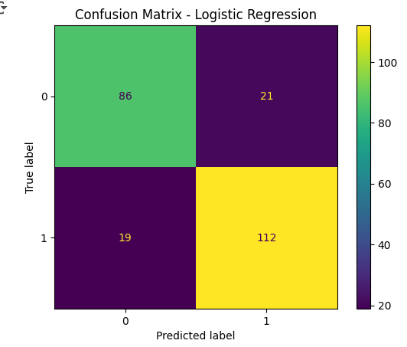
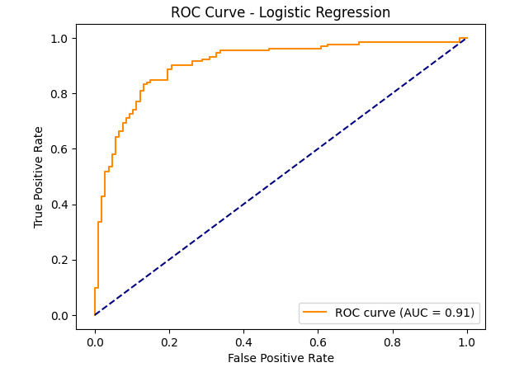
Logistic Regression

Slide 11
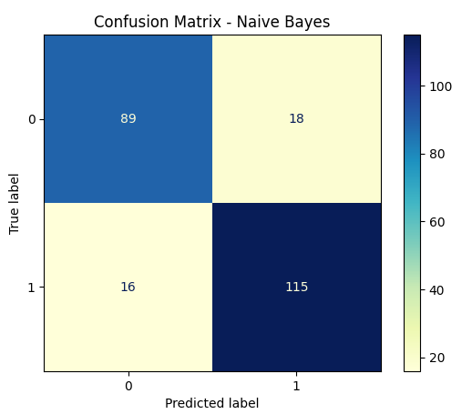
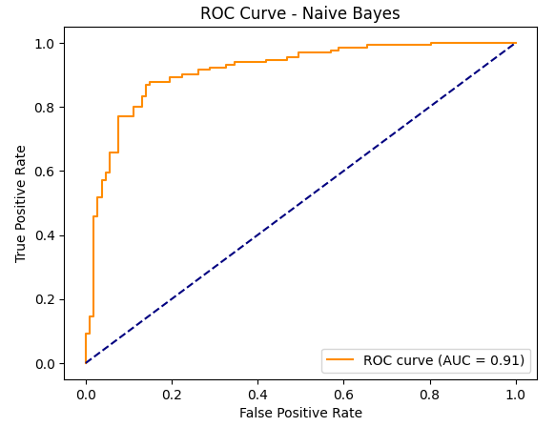
Naive Bayes

Slide 12
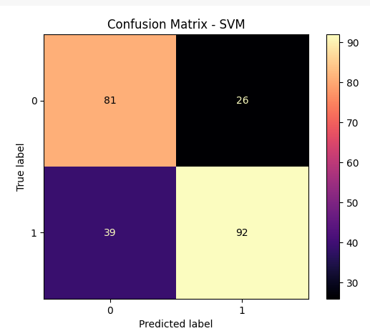
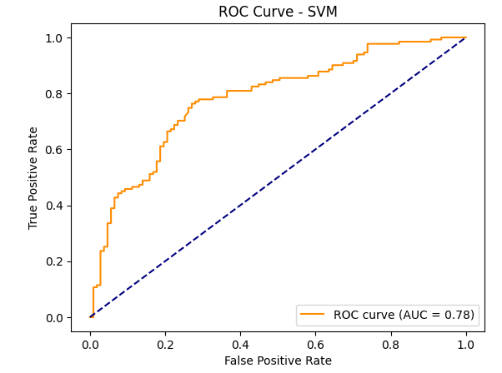
SVM

Slide 13
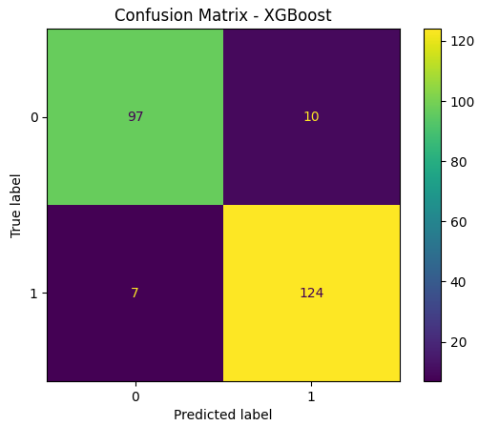
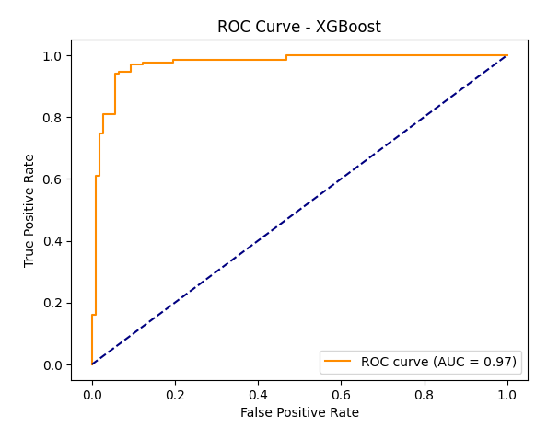
XGBoost

Slide 14
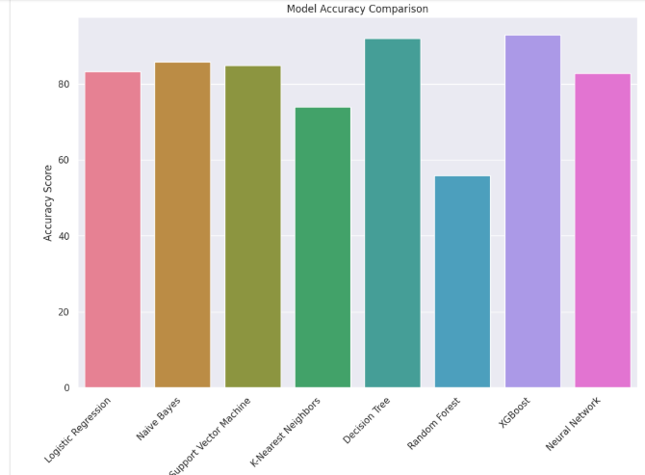
Model Comparison

Slide 15
Deployment Architecture
The final trained model was saved using joblib and deployed via a Flask web application. The web app consists of an HTML/CSS frontend that collects user inputs, which are sent to the Flask backend. The model processes the inputs and returns a prediction to the user interface, enabling real-time disease risk assessment.

Slide 16
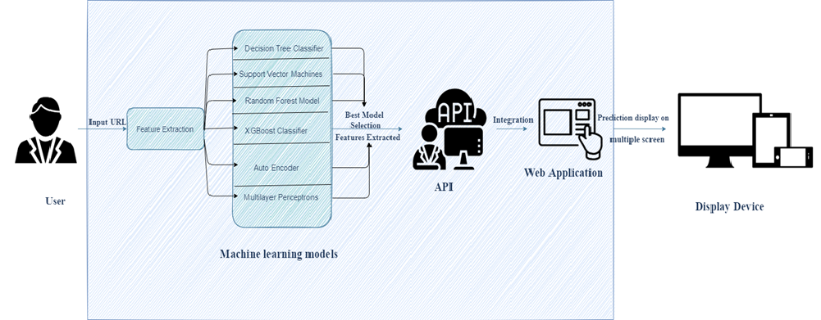
Architectural Design and Deployment
The trained model was integrated into a Flask web framework for deployment. The model was serialized using joblib and loaded into a Flask API endpoint. A simple HTML/CSS frontend was created to accept user inputs, which are sent to the backend via HTTP POST requests. The Flask server processes the inputs, applies the model, and returns the predicted price to the user through the interface.

Slide 17
Design of Web application
1. Web Application Development
Designed a user-friendly, browser-compatible web UI
Enabled input & prediction display
Built using HTML, CSS, JavaScript (or React)
2. Model Integration
Integrated final model into the backend (Flask/Django)
Connected model predictions to the frontend
Ensured real-time detection functionality
3. Deployment & Testing
Deployed web app to a live server
Tested for performance & user feedback
Ensured system stability and speed

Slide 18
User Interface
The user interface was designed for simplicity and ease of use using HTML and CSS. It includes fields for entering patient details such as age, gender, chest pain type, cholesterol, blood pressure, and other relevant parameters. Upon submission, the application displays whether the patient is likely to have heart disease.

Slide 19
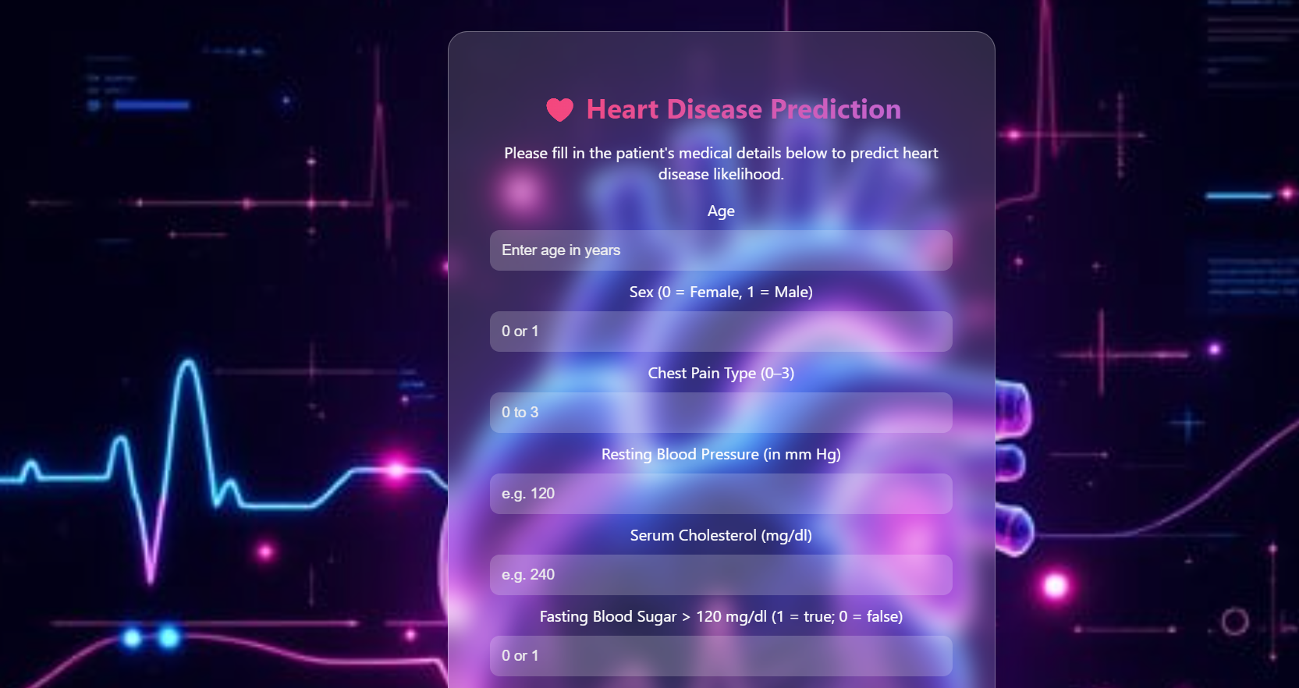
Heart disease Predictor – Web app

Slide 20
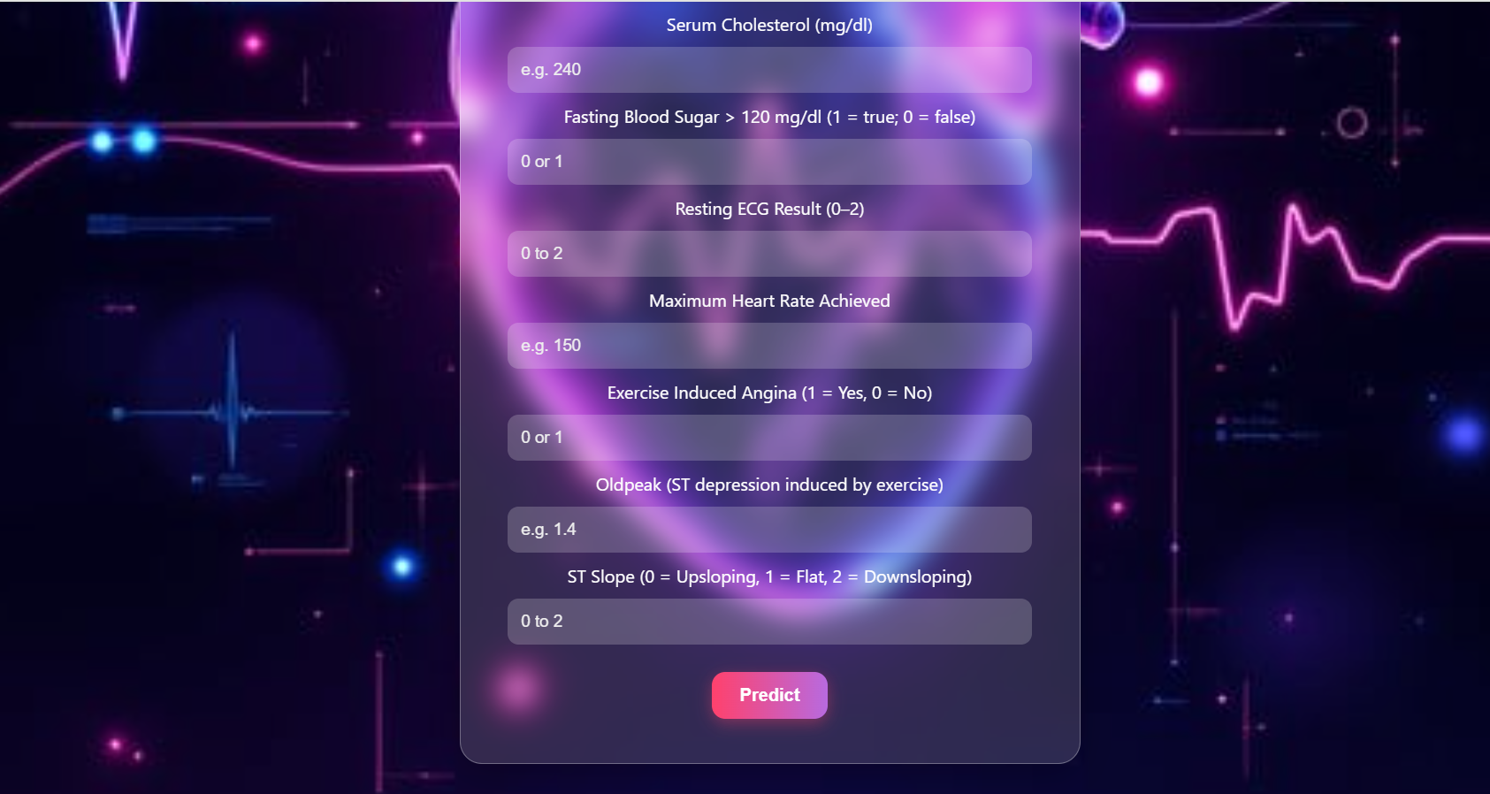
Heart disease Predictor – Web app

Slide 21
Use Case
This application can be used by healthcare professionals and diagnostic centers to screen patients for potential heart disease before conducting extensive tests. It aids in early diagnosis, prioritizing high-risk cases, and potentially reducing workload on medical staff.

Slide 22
Testing & Results
After deployment, the model was tested with multiple patient data entries. The predictions were accurate and aligned with expected outcomes based on the clinical indicators. The web app responded efficiently and provided results in real time, making it suitable for practical use.

Slide 23
Conclusion
This project successfully demonstrates the use of machine learning in medical diagnosis. By combining data science with healthcare data, we were able to build and deploy an effective heart disease prediction tool. The system helps identify high-risk individuals and can be used to support clinical decision-making.

Slide 24
Future Scope
Future enhancements could include integrating the model with wearable devices or hospital systems for live data input. Additionally, deploying the model on a cloud platform would improve accessibility and scalability. More features and larger datasets could also improve model accuracy and robustness.

Slide 25
Thank you

